Slide 1
ITP App
Student: Mitre FLAVIA ANTONIA
Year III, Computers in english 31b

Slide 2
ITP App Pages
Admin home page
Admin add rule page
Admin add car page
Cars page
Reviews page
Rules page
Welcome page
Register page
Login page
Profile page
Delete account page
Change password page
Change email page
Client home page
Client search cars page
Client add review page

Slide 3
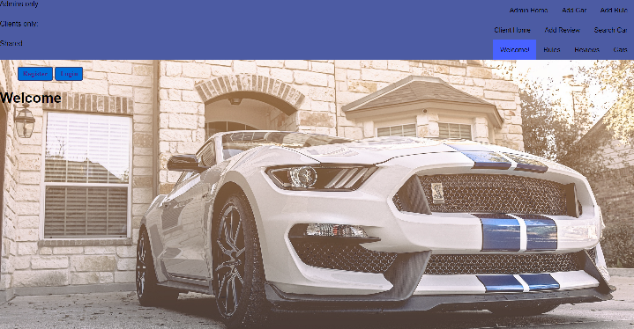
Welcome page
The first page of the site

Slide 4
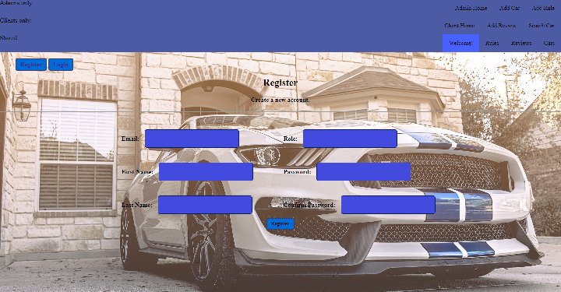
Register page
On this page a person can create an account: admin or client, giving some personal data

Slide 5
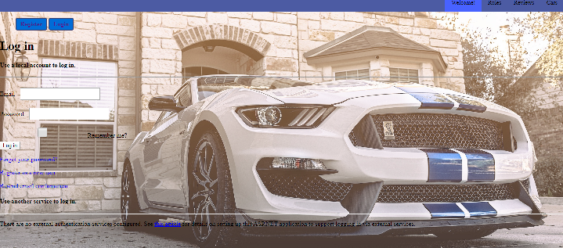
Login page
On this page a person can login with the account created

Slide 6
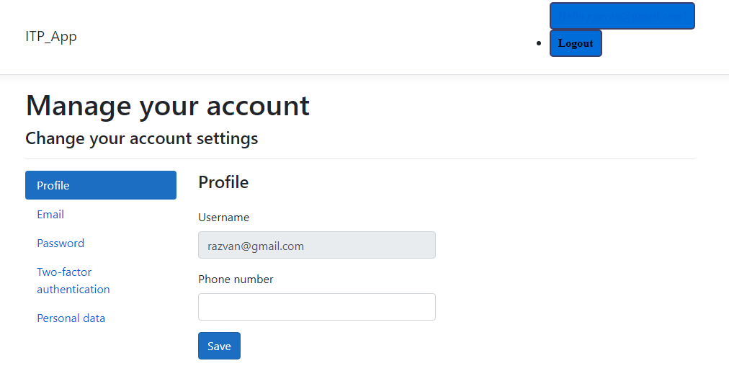
Profile page
On this page a person can see its profile

Slide 7
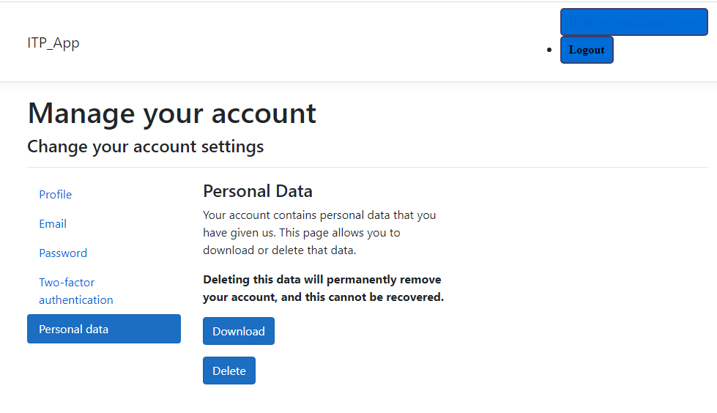
Delete account page
From this page a person can delete its account

Slide 8
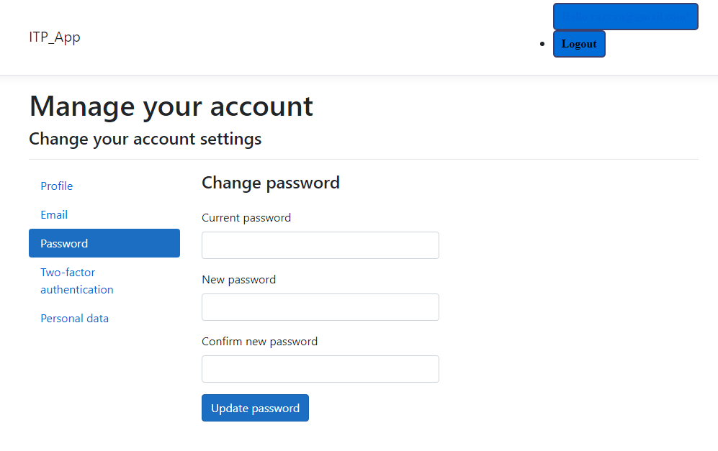
Change password page
On this page a person can manage its password

Slide 9
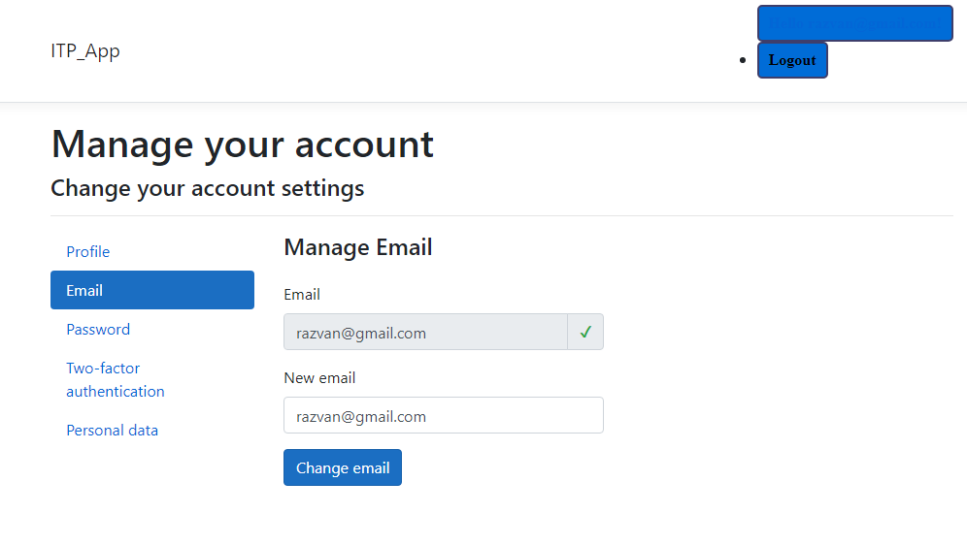
Change email page
On this page a person can manage its email

Slide 10
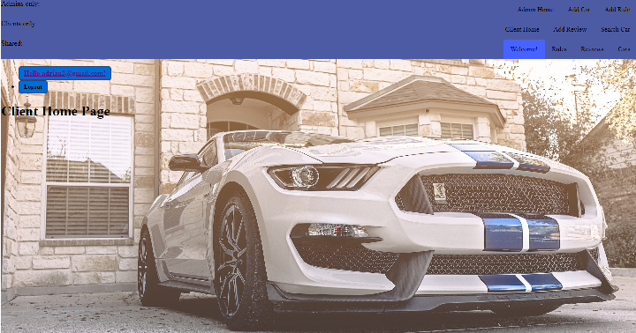
Client home page
This is the client home page

Slide 11
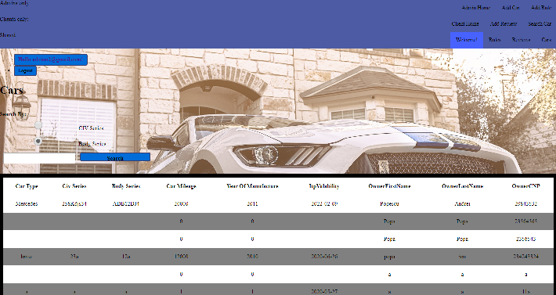
Client search cars page
On this page a client can search a car on the site, to see if the ITP is expired or not, and other car data. The searching can be performed for both CIV or body series.

Slide 12
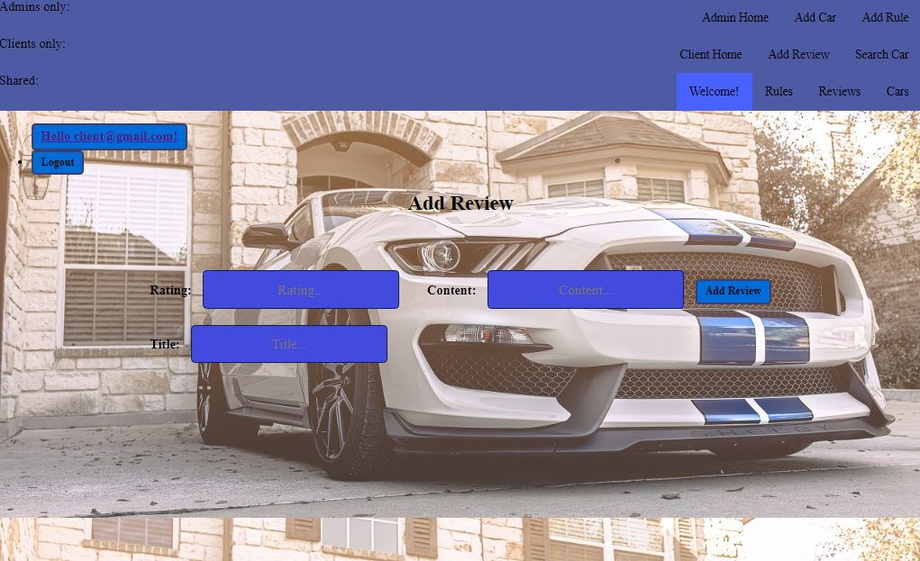
Client add review page
On this page a client can add a review for the site completing some data

Slide 13
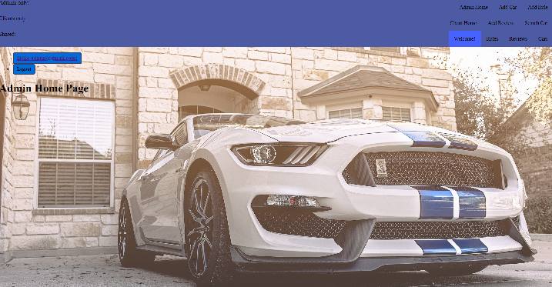
Admin home page
This is the admin home page

Slide 14
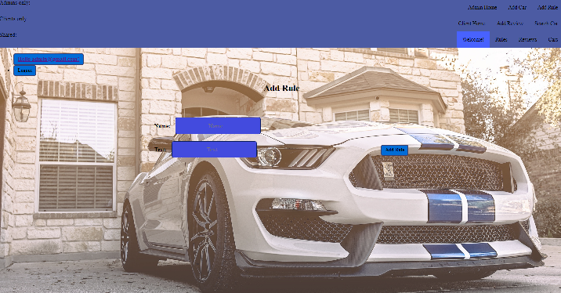
Admin add rule page
On this page an admin can add a rule providing some data

Slide 15
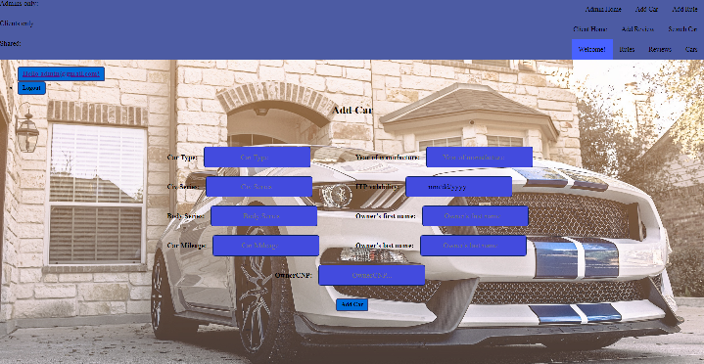
Admin add car page
On this page an admin can add a car providing some data

Slide 16
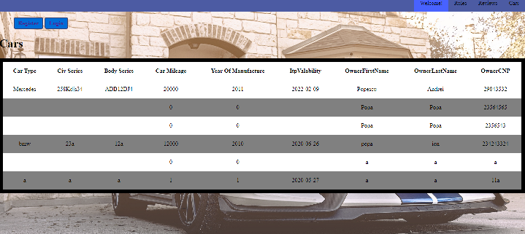
Cars page
On this page a person can see the cars registered on the site

Slide 17
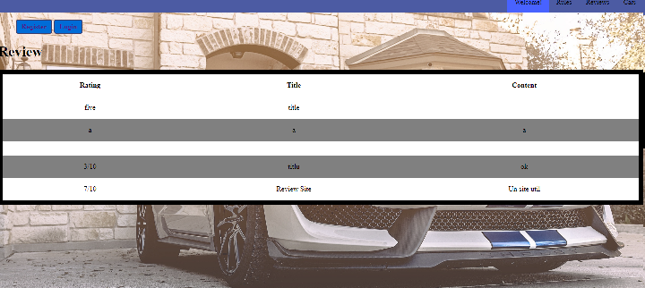
Reviews page
On this page a person can see the reviews of the site

Slide 18
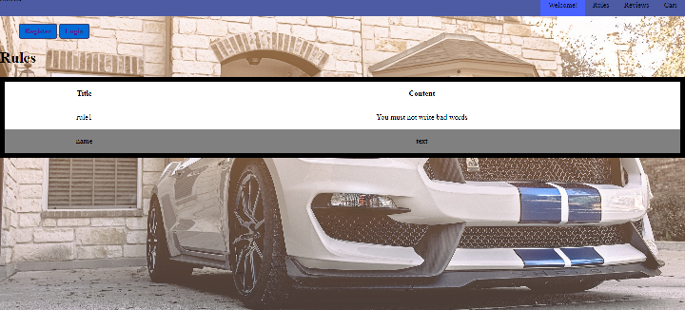
Rules page
On this page a person can see the rules of the site

